Slide 1
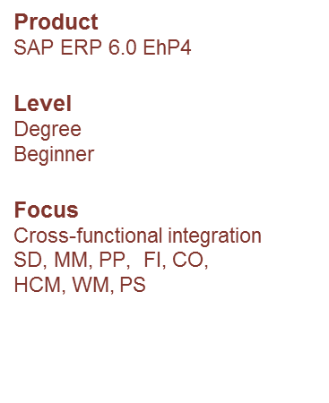
IBPSES
CT104-3-2
Module Overview
Abstract
This teaching material is intended to explain how the fundamental business processes interact with SAP ERP in functional areas such as Sales and Distribution, Materials Management, Production Planning, Financial Accounting, Controlling, and Human Capital Management.
Prepared by: KN First Prepared on: 01.08.12 Last Modified on: DD.MM.YY
Quality checked by: xxx
Copyright 2012 Asia Pacific University of Technology and Innovation

Slide 2
Lecturer information
Lecturer Name: Nur Khairunnisha Zainal
Email: khairunnisha.zainal@staffemail.apu.edu.my
Room: FCET lecturer room Level 5 (near to Block E)

Slide 3
Module Overview
Integrated Business Processes with SAP ERP System module approaches ERP topics using an integrated process perspective of the firm. Students will gain a deep appreciation for the role of enterprise systems in efficiently managing processes from multiple functional perspectives.
The module comprises lectures and lab sessions and involves independent learning skills within the practical exam

Slide 4
Aims of this module
The aim of the module is to:
Develop the ability of students to critically apply the knowledge they gain in relation to the study of Managing Business processes with SAP ERP System

Slide 5
Learning outcomes
At the end of the course the students will be able to:
Evaluate the role of SAP ERP systems in supporting business processes in procurement, fulfilment, production and warehouse management processes. (C5, PL01)
Demonstrate basic accounting, keys step in procurement fulfilment, production, warehouse management and material planning processes with SAP ERP System. (P5, PLO2)
3. Use SAP ERP system to promote various integrations in the business processes. (A3, PLO6)

Slide 6
Student Learning Time (SLT)
Module Credit Value: 3
Total Learning Hours:
Lecture: 14 hours per semester
Practical: 28 hours per semester
Independent Learning Time: 66 hours

Slide 7
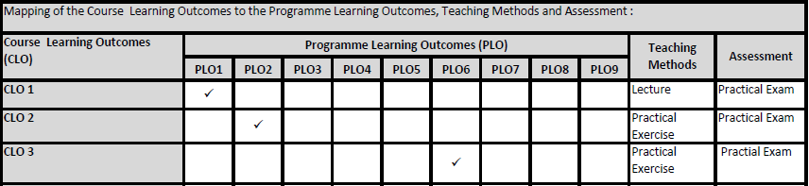
Mapping of CLOs with MOEs Domain
PLO1 – Knowledge
PLO2 – Practical Skills
PLO6 – Problem Solving and Scientific Skills

Slide 8
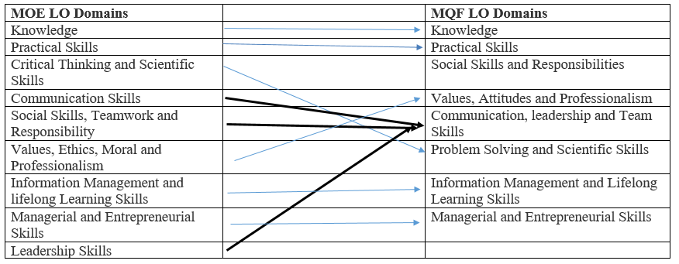
MQF and MOE Domains

Slide 9
Teaching Strategies
Lecture
Practical (Lab)
** Blended / Flipped Learning using Microsoft Teams

Slide 10
Module Overview
Integrated Business Processes with SAP ERP System module approaches ERP topics using an integrated process perspective of the firm. Students will gain a deep appreciation for the role of enterprise systems in efficiently managing processes from multiple functional perspectives.
The module comprises lectures and lab sessions and involves independent learning skills within the practical exam

Slide 11
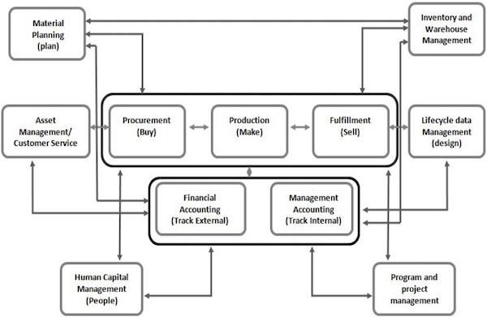
Topics we will cover
ERP

Slide 12
How you will be assessed
100% in course Assessment
Assessment | Weighted
Practical Exam (2 Hours) | 100 %

Slide 13
Methods of Delivery
Hence, We are now moving from the traditional topic based teaching to outcome-based education (OBE).
OBE is education based on producing particular educational outcomes that:
Focus on what students can actually do after they are taught
Expect all learners / students to successfully achieve particular (sometimes minimum) level of knowledge and abilities

Slide 14
Course Content Outline
CLO1, CLO2 and CLO3 : Lecture & Lab
Week | Topic
Week 1 | Module Introduction Introduction to assignment details Assessments Briefing Introduction to the subject area
Week 2 | Chapter 1: Introduction to Enterprise system & SAP Introduction to Business Processes. Introduction to Enterprise Systems & SAP Data in Enterprise system GBI Story

Slide 15
Topics we will cover
Week | Topic
Week 3 &4 | Chapter 2: The Fulfilment Process
Week 5 | Chapter 3: Material Management
Week 6 | Chapter 4: Warehouse Management
Week 7 | Chapter 5: The Production Process
Week 8 | Chapter 6: Financial Accounting
Week 9 | Chapter 7: Management Accounting
Week 10 | Chapter 8: Human Resource Management

Slide 16
Topics we will cover
Week | Topic
Week 11 | Chapter 9: Enterprise system technologies
Week 12 | Integration: Procurement, Fulfilment, Production and IWM Processes
Week 13 | Revision
Week 14 | Exam

Slide 17
What is expected of you
What is expected of you
Punctuality – Late and Absent
Mobile phone
to be switched off or in silent mode
not to be used during lectures/tutorial
answer calls outside class (only when necessary)
No meals in class
Adherence to APU dress code
Timely submission of assignment and milestone
No unnecessary internet surfing

Slide 18
What is expected of you
Attendance and Punctuality
Class attendance is an individual student responsibility.
Attendance is compulsory and valid medical certificates or letters from parents /guardians must support any absence from class.
Three lateness will be equal to one absence
Attendance:
Min 80% attendance requirement holds for BOTH Exam and IN COURSE based assessments.
Students have to Retake the module with attendance even if it’s a 100% coursework based assessment if they do not fulfil the minimum attendance requirement.
If there is a “No show” for the Exam, it will normally result in Retake with attendance

Slide 19
What support is available for you
Student Assessment Information Sheet (SAIS)
Module slides
Webspace
Microsoft Teams
Consultation hours (Lecturer consultation Hours)
E-mail
khairunnisha.zainal@apu.edu.my
Resources
Reference material
Essential reading
Additional reading

Slide 20
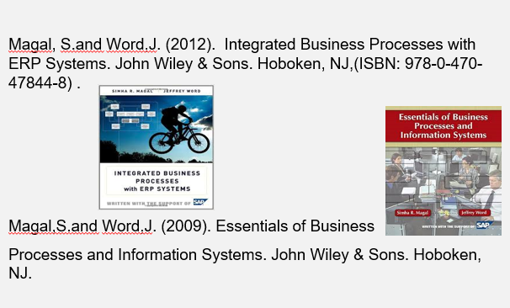
References supporting the course

Slide 21
Question and answer session
Q & A

Slide 22
What we will cover next
SAP GUI installation
GBI Story

